Slide 1
















Presenter
HYPERTECH SA
SCENE Policy workshop, 16.01.2026, Online
Future policy needs for European filmmaking
Funded by the European Union’s Horizon Europe Research and Innovation Actions programme under grant agreement No 101095303.

Slide 2
What we’re doing and why
SCENE’s Policy Delphi exercise (2 rounds)
SCENE is running an expert study on policy needs for EU filmmaking
Round 1: mapped themes (exploratory)
Round 2: validates and prioritizes statements
Today: sense-check priorities and sharpen the final policy brief

Slide 3
Today’s goal
What we aim to achieve in 2 hours
Expected Outputs:
A ranked shortlist of policy priorities
2–3 “policy packages” (what must move together)
Key implementation bottlenecks & success criteria
A clear prompt to complete Round 2 (for those who haven’t)
How we’ll work
Short evidence snapshot (Round 1 + what we have so far)
Fast prioritization (Google Form + Slido)
Chat-based package-building (2-part combinations)
10-minute open discussion buffer

Slide 4
Round 1: What the first stage mapped
Exploratory expert input (themes & clusters)
Key messages from Round 1
Sector change is systemic: technology, platforms/audiences, and financing conditions are intertwined
Top structural barriers: unequal access to funding; restrictive/outdated frameworks; workforce precarity & skills gaps; rising costs; platform dominance
AI is a major driver, but repeatedly connected to authorship, jobs, and value of creativity (not “just tech”)
EU support perceived as stronger on diversity and moderate on technology; funding/incentives more uneven across contexts
Strongest convergence in “one change only”: simplify access to funding and reduce bureaucracy in practice
Takeaway for today: prioritise policy “packages” (bundles), not isolated fixes.

Slide 5
Round 2 so far
Who responded (n=28)
Early Round 2 sample (n=28, export 15 Jan 2026)
Mix: producers/freelancers, film funds/commissions, tool providers
High experience: most have 11+ years
Note: some regional skew (more Southern Europe)
Link to survey: https://ec.europa.eu/eusurvey/runner/c8b1a312-3605-f8e5-65b6-d38c9dda03dc

Slide 6
Draft policy directions to test today
A practical “menu” derived from Round 1 themes
Options to prioritise and package.
1) Funding usability reform
2) Skills + access at scale
Simpler, faster, fairer access; reduce administrative burden; improve alignment across Europe.
Training pipelines, capacity building, and affordable access to tools/infrastructure across regions.
3) AI governance baseline
4) Distribution & visibility measures
Practical rules on authorship/credit, transparency of AI use, accountability, and fair implementation.
Discoverability, long-tail circulation, and fair conditions in platform-driven distribution.
5) Cross-border integration mechanisms
Smoother co-production and circulation; interoperability of schemes; reduce fragmentation barriers.

Slide 7
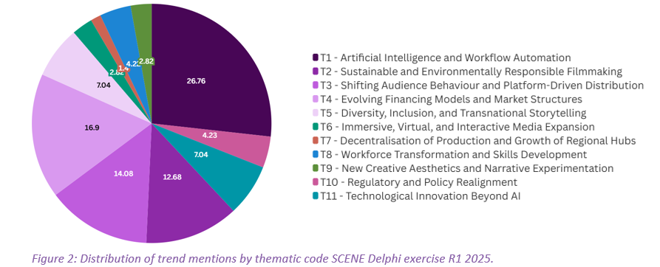
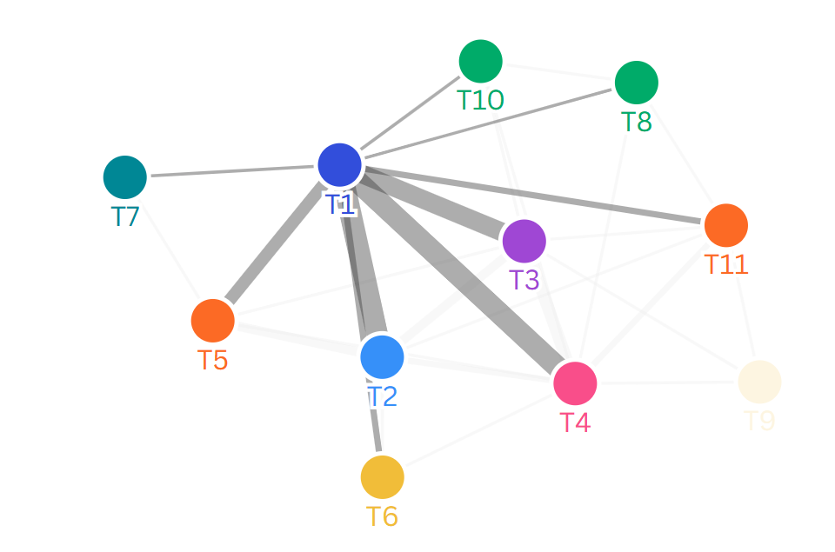
Trends
The “hub” pattern is unchanged
Round 2: AI & workflow automation dominates (25/28)
Other major forces:
Audience/platform shift
Sustainability requirements
Diversity/transnational storytelling
Skills/workforce transformation
R2 R1

Slide 8
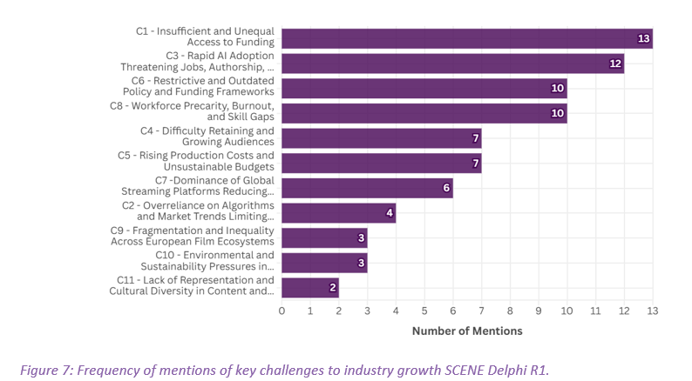
Constraints
A pressure triangle
R2 R1
Top constraints in Round 2:
Rising costs / unsustainable budgets
Unequal access to funding
AI risks to jobs/authorship/value
Next tier: audiences, platform power, working conditions

Slide 9
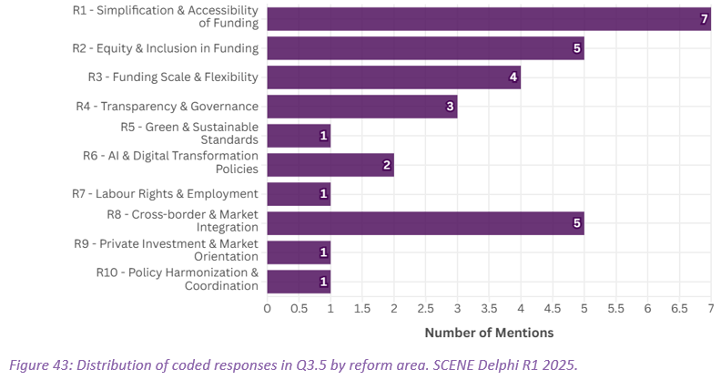
Driver policy change
What policy change “unlocks the others”?
R2 R1
Most chosen “unlock” lever:
Simplify funding access & reduce admin burden
Close contenders:
Financing innovation for risk/innovation
Platform fairness / market regulation
Also present: IP/rights, cross-border, infrastructure, skills

Slide 10
The strongest convergence
“ONE change” to shift fastest
Round 2: Make funding schemes simpler/faster/more accessible (13/28)
Then:
Platform/streamer rules for fairness & EU visibility
Cross-border cooperation mechanisms

Slide 11
Artificial Intelligence
Non-negotiables
Top “non-negotiables”:
Authorship/credit + human creative control
Transparency / disclosure when AI is used
Human oversight in key creative decisions
Also: consent/data rights, labor protection, liability

Slide 12
Digital weakest link
It is not where many expect
Weakest link: Distribution / audience reach (15/28)
Biggest integration barriers:
AI risks
skills/training gaps
unequal access + fast tool obsolescence
What helps most: funding reform + training + affordable access

Slide 13
External pressure + 2035 outlook
Future expectations
Biggest external risk signal: funding tightens
Platform rule changes: medium-to-high impact
2035 expectations: mixed (tech-led growth vs moderate growth vs stagnation)

Slide 14
Concrete policy options (examples)
What to react to during discussion
A) Funding usability (fast wins)
B) AI baseline governance
C) Distribution & visibility
Lighter application pathway for smaller projects
Clear time-to-decision targets and criteria transparency
Reduce duplicated admin across schemes where possible
Fairer access across regions and organisational sizes
Disclosure/transparency when AI is used (proportionate)
Authorship/credit protection + meaningful human control
Contract guidance: rights, remuneration, accountability
Practical implementation support for funds & producers
Support tied to discoverability and long-tail circulation
Improved access to audience insights where feasible
Measures that address imbalance of market power
Cross-border circulation pathways & interoperability

Slide 15
Interactive session
We’ll prioritise → build packages → stress-test feasibility
Notes:
[Sources] - Internal workshop design. [/Sources]

Slide 16
Interactive prioritization
Please open the link in the chat (Google Form)
Answer as you go
Most questions are quick picks (all optional)
If you get interrupted, submit what you can — partial responses still help
https://docs.google.com/forms/d/e/1FAIpQLSfyYNzMCbg4_aUND5MBimUsHkA7EHpE7K5ExHcmAFcazdiBWw/viewform?usp=header

Slide 17
Block 1: Priority direction (Q1–Q3)
(3 minutes)
Q1: Which policy direction should come first (2026–27)? (Pick 1)
Q2: Your top 2 directions overall (Pick exactly 2)
Q3: In one sentence, what does “success by 2027” look like?

Slide 18
Block 2: Policy packages (Q4–Q5)
(2 minutes)
Q4: Which two-part package should be prioritised first? (Pick 1)
Q5 (optional): If “Other”, write: [A] + [B]

Slide 19
Block 3: Concrete policy options (Q6–Q7)
(3 minutes)
Q6. Funding usability: pick two measures with biggest impact (Pick exactly 2)
Q7 Distribution & visibility: pick two actions that matter most (Pick exactly 2)

Slide 20
AI governance baseline (Q8–Q10)
(3 minutes)
Q8. Pick two non-negotiables for AI governance (Pick exactly 2)
Q9. Wording test keep / reword / no
Q10. If rewording (optional): suggest 1–2 sentences

Slide 21
Feasibility & bottlenecks (Q11–Q12)
(3 minutes)
Q11. Biggest bottleneck to implementing your preferred package (Pick 1)
Q12. Who must act first? (pick 1)

Slide 22
Final inputs
(2 minutes)
Q13. One example we should capture:
Any concrete example, pain point, or “good practice” we should capture for the policy brief? (2–5 lines)

Slide 23
FOLLOW US
SCENE EU Project
SCENE EU Project
Visit: thesceneproject.eu
Contact: info@thesceneproject.eu
@SceneProjectEU
@SCENEEUProject
[insert here individual contact details]
Funded by the European Union’s Horizon Europe Research and Innovation Actions programme under grant agreement No 101095303.

